Slide 1
Supercritical Fluid Chromatography
PRESENTED BY : Miss. Vasudha Bavdekar

Slide 2
CONTENTS
1.Introduction
2.Definition
3.Principle
4.Instrumentation
5.Advantages
6.Disadvantages
7.Applications
8.Conclusion
9.References

Slide 3
INTRODUCTION
Supercritical fluid chromatography(SFC) was first
proposed in 1958 by J. Lovelock.
First used in1962 by Klesper.
It is used for the analysis & purification of low moderate molecular weight, thermally liable molecules.

Slide 4
DEFINITION
A supercritical fluid chromatography is a material that can be either liquid or gas used in state above critical temperature or critical pressure where gases or liquid can co exist.

Slide 5
PRINCIPLE
Principles are similar to those of High Performance Liquid Chromatography (HPLC), however SFC typically utilizes carbon dioxide as the mobile phase; therefore the entire chromatographic flow path must be pressurized. Because the supercritical phase represents a state in which liquid and gas properties converge, supercritical fluid chromatography is sometimes called "convergence chromatography."

Slide 6
INSTRUMENTATION
1.Stationaryphase
2.Mobile phase
3.Pumps
4.Injectors
5.Ovens
6.Columns
7.Detectors

Slide 7
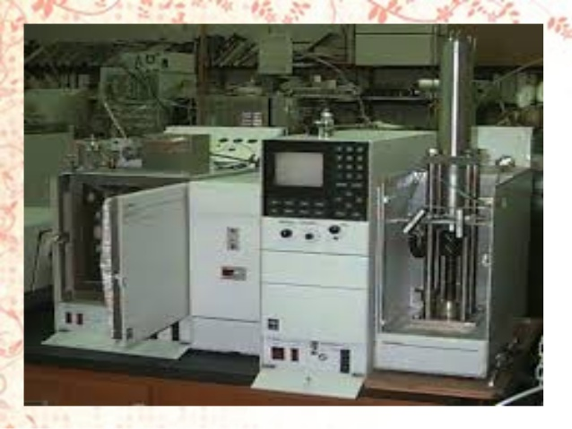

Slide 8
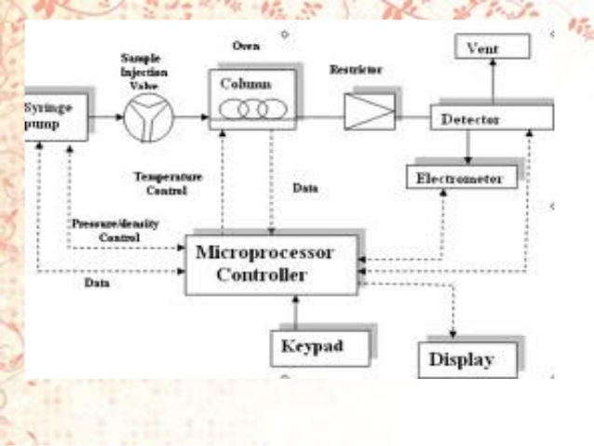

Slide 9
STATIONARY PHASE
Both packed and open tubular columns are used.
Packed columns can provide more theoretical plates and handle large volume than open tubular columns.
Because of low viscosity of super critical media.
The column length is 10 to 20m. and inside the diameter is 50 to 100mm common in open tubular columns.

Slide 10
Cont…
For difficult separation column 60m (or) large have been used.
Packed column usually made up of stainless steel,10 to 25cm.
More than 100,000 plates have been achieved in plate column.
Many of column coating used in LC have been applied to SFC
as well.
Typically their are polysiloxane chemically bounded wall of
capillary tubing .

Slide 11
MOBILE PHASE
The mobile phase is composed primarily of super critical carbon dioxide, but since CO₂ on its own is too non-polar to effectively elute many analytes, co-solvents are added to modify the mobile phase polarity.
Co-solvents are typically simple alcohols like methanol, ethanol or isopropyl alcohol. Other solvents such as acetonitrile, chloroform or ethyl acetate can be used as modifiers.

Slide 12
Cont …
Modify valves for analytes ,ethane, pentane, diethyl ether, ammonia.
Pressure maintained is 72.9 atm, temperature is 35ºc.

Slide 13
PUMPS
Here mainly flow control is necessary so syringe pumps are used for capillary SFC for consistent pressure and for packed columns for easier blending of the mobile phase or introduction of modifier fluids reciprocating pumps are used.

Slide 14
INJECTORS
In capillary SFC small sample should be quickly injected into the column and so pneumatically driven valves are used.
For packed SFC a typical injection valve is commonly used.

Slide 16
OVENS
Conventional GAS chromatography & liquid chromatography ovens are used.

Slide 17
COLUMNS
Two types of analytical columns are used in SFC i.e. packed and capillary.
Packed columns contain small deactivated substances to which the stationary phase adheres. These are conventionally stainless steel.
Capillary columns are open tubular columns made of fused silica which have small internal diameter.

Slide 18
DETECTORS
Flame ionization detectors and flame photometry detector, liquid-phase detectors like refractive index detector, ultraviolet-visible spectro- photometric detectors and light scattering detectors have been employed for SFC.

Slide 19
ADVANTAGES
SFC is emerging as a separation technique that is superior to both gas chromatography and liquid chromatography for analysis of thermal liable or non volatile compounds.
Low viscosity.
Lower operating temperature.
High diffusion co efficient.
High resolution at low temperature.

Slide 20
DISADVANTAGES
SFC is pressure operating conditions. High-pressure vessels are expensive and bulky.
Maintaining pressure in SFC is difficult.
supercritical fluids are highly compressible and their physical properties change with pressure.
Cleaning will be time consuming.

Slide 21
APPLICATIONS
SFC is used in industry primarily for separation of chiral molecules.
SFC now commonly used for chiral separation and purification in the pharmaceutical industry.
SFC technique has been applied to wide verity of materials, including natural products, drugs, food and polymers etc.

Slide 22
CONCLUSION
In overall ranking of chromatographic techniques it can be judges that SFC falls somewhere between HPLC and GC.
In field of pharmaceutical chemistry and bioanalytical applications SFC gained its applications.

Slide 23
REFERENSES
Muneo Saito (2008), [pdf Supercritical Fluid Chromatography: A New Technology?], Packed Column SFC 2008, Switzerland.
Super critical fluid chromatography “Skoog” instrumental analysis pg: 935 to 940.
Supplement and Cumulative Index, Edited by Bryant W. Rossiter and Roger C. Baetzold. Physical Methods of Chemistry Series, 2nd ed., Vol. X. ISBN 0-471-57086-9 0 1993 John Wiley & Sons, Inc.

Slide 24
THANKS for viewing the ppt
For more ppts
on pharma related topics plz contact
sarangi.dipu@gmail.com
Or find me at following link
www.facebook.com/sarangi.dipu

